Slide 1
BOOTSTRAP
Bharath Vignesh J K
19PW08

Slide 2

What is Bootstrap?
Bootstrap is a free front-end framework (HTML and CSS) for faster and easier web development.
Bootstrap is famous for being developed with components that have the ability to follow the property of responsive designs
Responsive Design is about using CSS and HTML to resize, hide, shrink, enlarge, or move the content to make it look good on any screen
Responsive Design allow your page works for computer, tablets and mobile phones.
Latest Version : 4.4
Notes:
In other words, bootstrap is a collection of CSS classes and JavaScript functions the you get ready to use

Slide 3
A Bootstrap Page
Include the HTML5 doctype at the beginning of the page, along with the lang attribute and the correct character set.
Meta viewport tag ensure proper rendering and touch zooming. Width of the page to follow the screen-width of the device and initial zoom level to default zoom level.
User will have a better experience, thus will not need zoom the page to view page information
You will need to include three files:
bootstrap.min.css
jquery.min.js
bootstrap.min.js

Slide 4
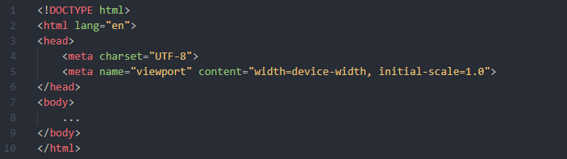
A Bootstrap Page

Slide 5
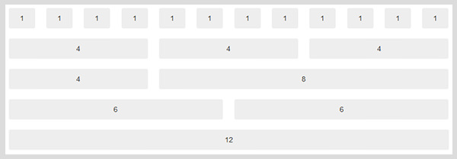
Bootstrap Grids
Bootstrap has a concept of containing element to wrap site contents.
Grid systems are used for creating page layouts through a series of rows and columns that house the content.
Rows must be placed within a .container (fixed- width) or .container-fluid (full-width) for proper alignment and padding. Rows to create horizontal groups of columns.

Slide 6
Bootstrap Tables
7 main classes:
.table
.table-striped
.table-bordered
.table-borderless
.table-hover
.table-dark
.table-sm
9 contextual classes:
.active
.success
.info
.warning
.danger
.primary
.secondary
.light
.dark

Slide 7
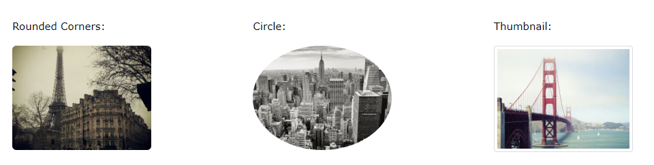
Bootstrap Images
Image classes
.img-responsive
.img-thumbnail
.img-rounded
.img-circle

Slide 8
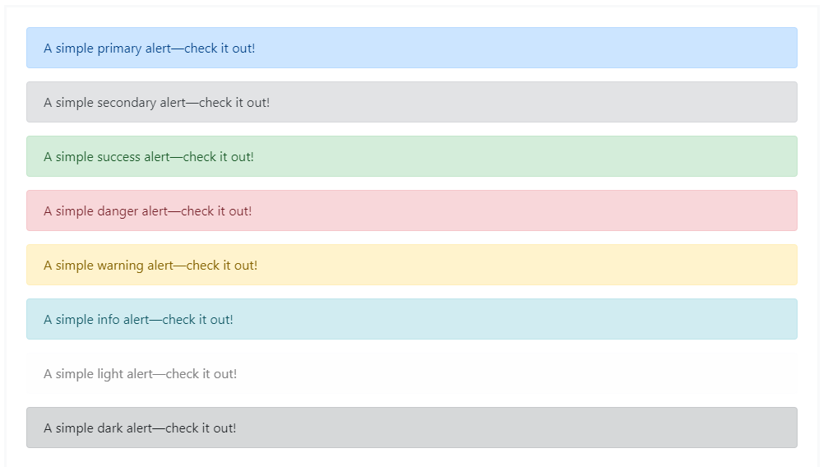
Bootstrap Alerts
9 alert classes:
.active
.success
.info
.warning
.danger
.primary
.secondary
.light
.dark

Slide 9
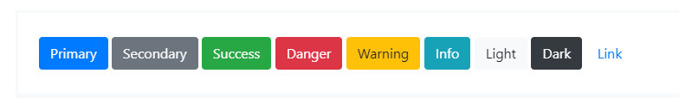
Bootstrap Alerts
9 Button classes:
.btn-link
.btn-primary
.btn-secondary
.btn-success
.btn-info
.btn-warning
.btn-danger
.btn-light
.btn-dark

Slide 10
Bootstrap Templates
Bootstrap offers many other templates for other requirements such as Navbars, Cards, Spinners, Tooltips and so on.
The documentation can be found at : https://getbootstrap.com/docs/4.4/
References:
https://getbootstrap.com/
https://www.w3schools.com/

Slide 11

THANKS!
Any questions?

